Slide 1


Operating a Generator Paralleled to the Grid
Dr. Norbert Doerry and Dr. John V. Amy Jr.
http://doerry.org/norbert/MarineElectricalPowerSystems/index.htm
© 2025 by Norbert Doerry and John Amy
This work is licensed via: CC BY 4.0 (https://creativecommons.org/)

Slide 2
Introduction
The steady state operation of a generator connected to a grid is different than when it is operating standalone
Standalone
  Voltage Regulator controls the voltage at the terminals
  Speed Governor controls the frequency
Paralleled to grid
  Voltage Regulator controls the Reactive Power supplied by the generator
  Speed Governor controls the Real Power supplied by the generator

Slide 3
Purpose of this video
Using a DC Motor to represent a prime mover and an AC synchronous generator ….
  Demonstrate how field excitation on the DC motor and on the AC Generator control speed (Frequency) and voltage when the generator is not paralleled to the grid
  Demonstrate how field excitation on the DC motor and on the AC Generator control Real and Reactive Power when the generator is paralleled to the grid.

Slide 4
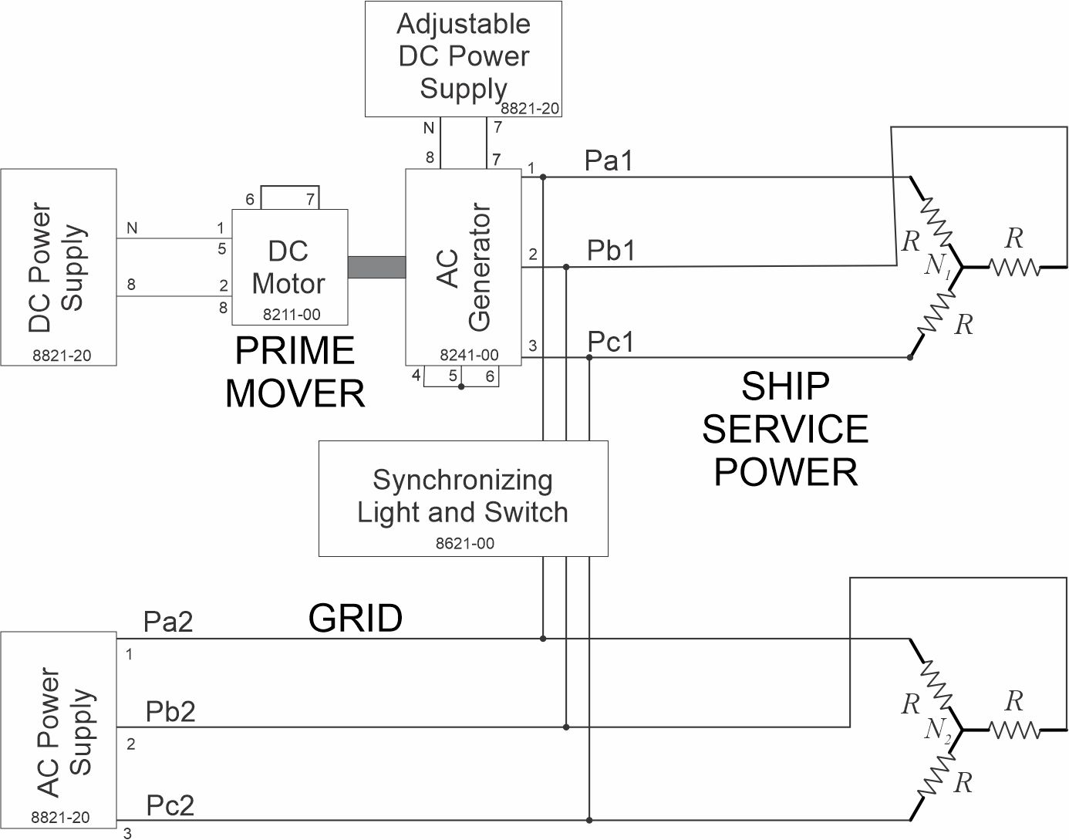
Schematic
Power Meter
- Output of AC Generator
Voltage / Frequency Meters
- Output of AC Generator
- Output of AC Power Supply

Slide 5
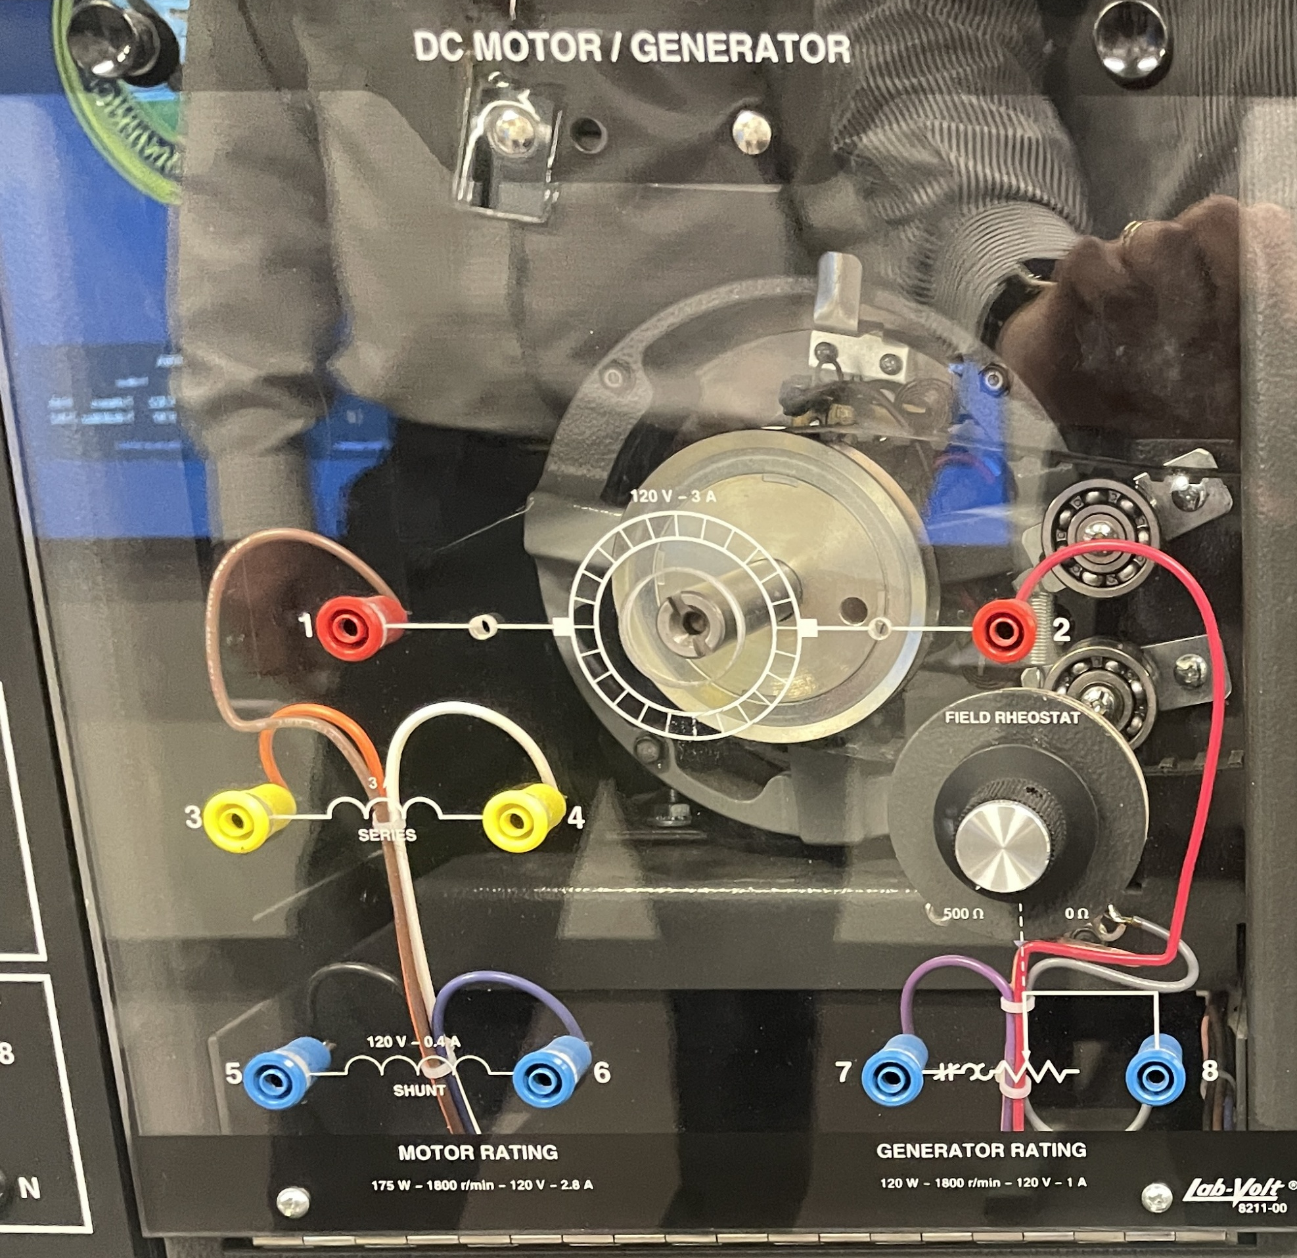
Prime Mover
Modeled by a DC motor
  Constant DC Voltage applied to the Armature (Rotor) {1 and 2}
  Field Rheostat controls current to the Shunt Winding on the stator (Field)
    Shunt winding {5 and 6}
    Field Rheostat {7 and 8}
    Connected in series
      DC voltage {5 and 8}
      Series connection {6 and 7}

Slide 6
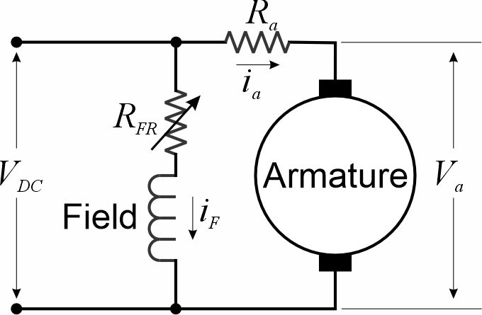
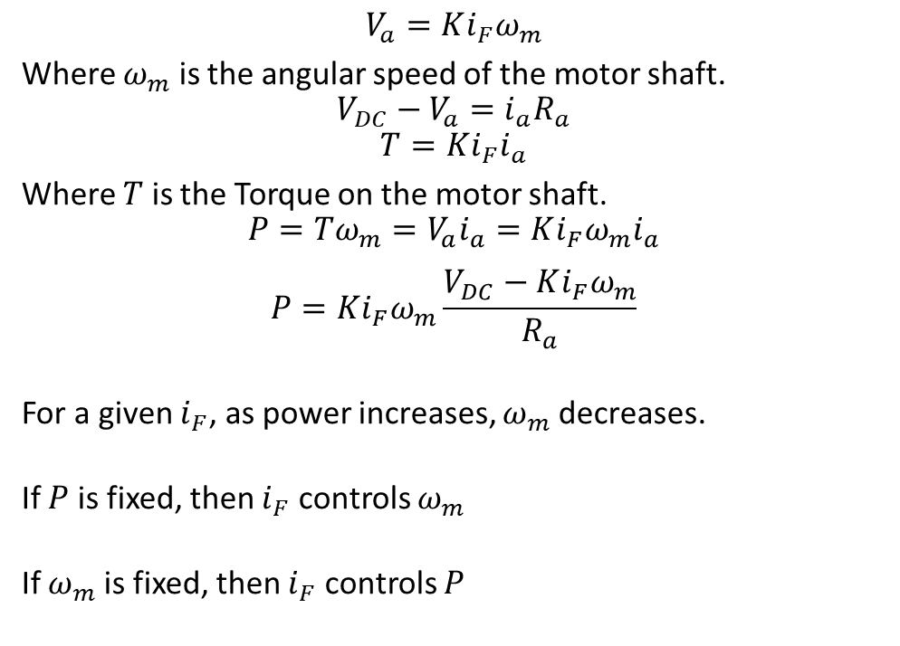
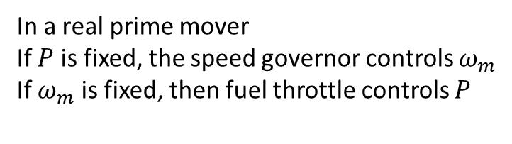
Steady State DC Motor Theory
$$V_{a}=Ki_{F}ω_{m}$$
Where $ω_{m}$ is the angular speed of the motor shaft.
$$V_{DC}−V_{a}=i_{a}R_{a}$$
$$T=Ki_{F}i_{a}$$
Where $T$ is the Torque on the motor shaft.
$$P=Tω_{m}=V_{a}i_{a}=Ki_{F}ω_{m}i_{a}$$
$$P=Ki_{F}ω_{m}\frac{V_{DC}−Ki_{F}ω_{m}}{R_{a}}$$
For a given $i_{F}$, as power increases, $ω_{m}$ decreases.
If $P$ is fixed, then $i_{F}$ controls $ω_{m}$
If $ω_{m}$ is fixed, then $i_{F}$ controls $P$
In a real prime mover
If $P$ is fixed, the speed governor controls $ω_{m}$
If $ω_{m}$ is fixed, then fuel throttle controls $P$

Slide 7
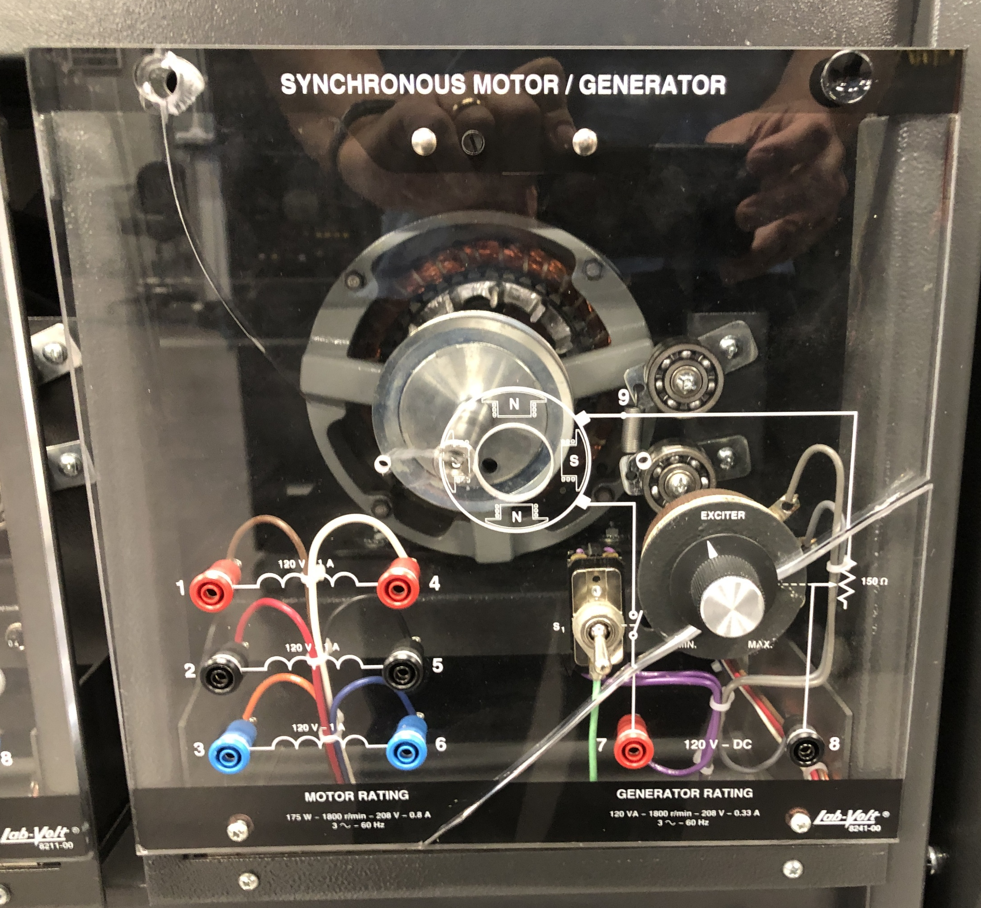
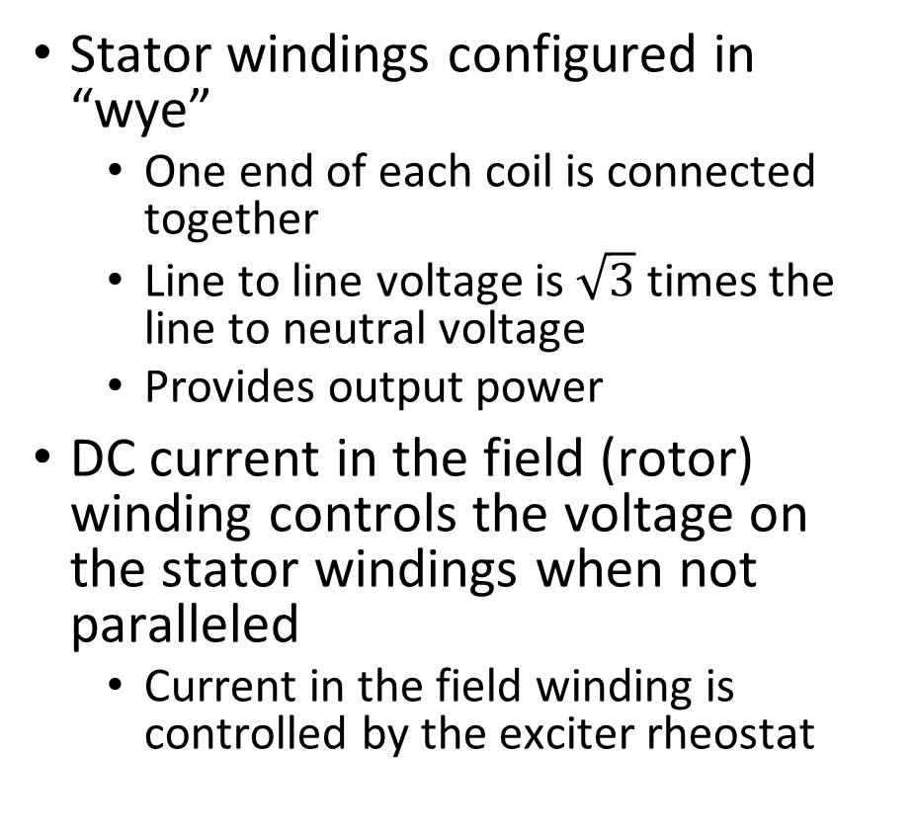
AC Generator
Stator windings configured in “wye”
  One end of each coil is connected together
  Line to line voltage is $\sqrt{3}$ times the line to neutral voltage
  Provides output power
DC current in the field (rotor) winding controls the voltage on the stator windings when not paralleled
  Current in the field winding is controlled by the exciter rheostat

Slide 8
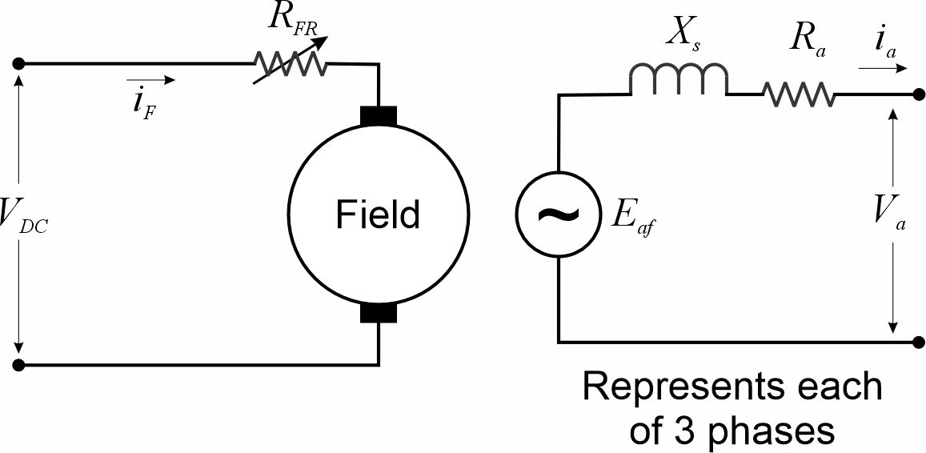
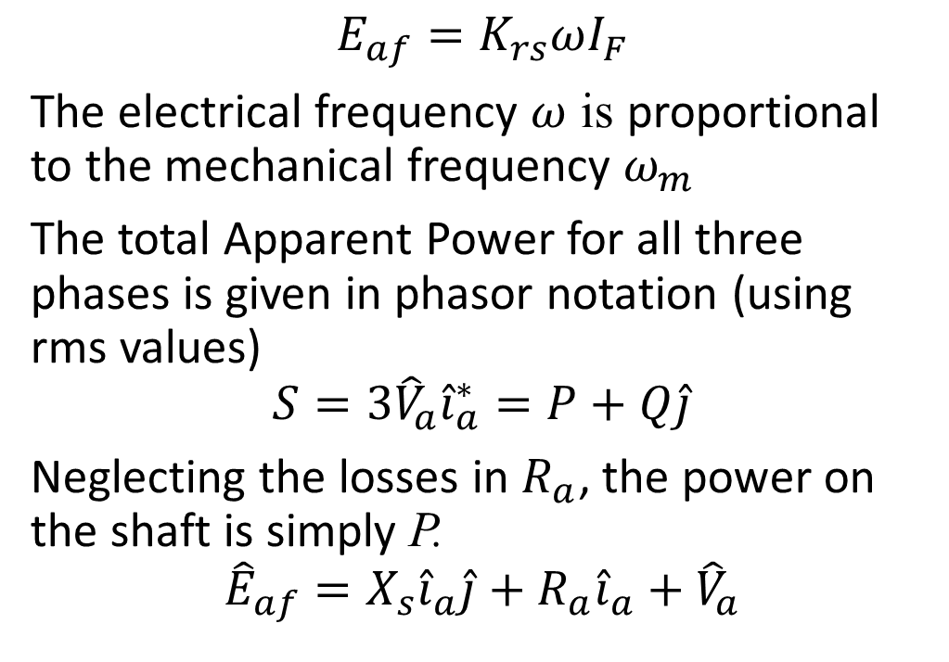
Steady State AC Synchronous Generator Theory
$$E_{af}=K_{rs}ωI_{F}$$
The electrical frequency $ω$ is proportional to the mechanical frequency $ω_{m}$
The total Apparent Power for all three phases is given in phasor notation (using rms values)
$$S=3{\hat{V}}_{a}{\hat{i}}_{a}^{∗}=P+Q\hat{j}$$
Neglecting the losses in $R_{a}$, the power on the shaft is simply P.
$${\hat{E}}_{af}=X_{s}{\hat{i}}_{a}\hat{j}+R_{a}{\hat{i}}_{a}+{\hat{V}}_{a}$$

Slide 9
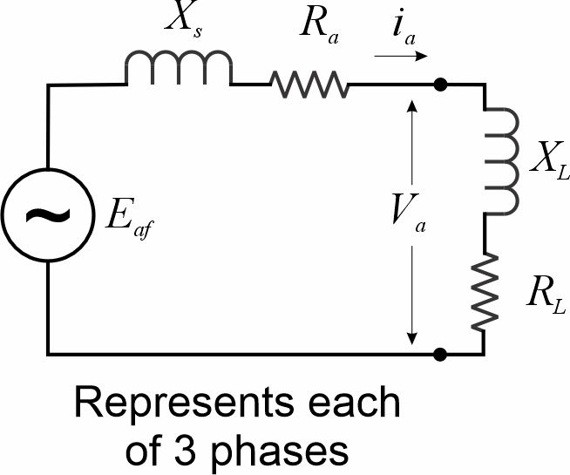
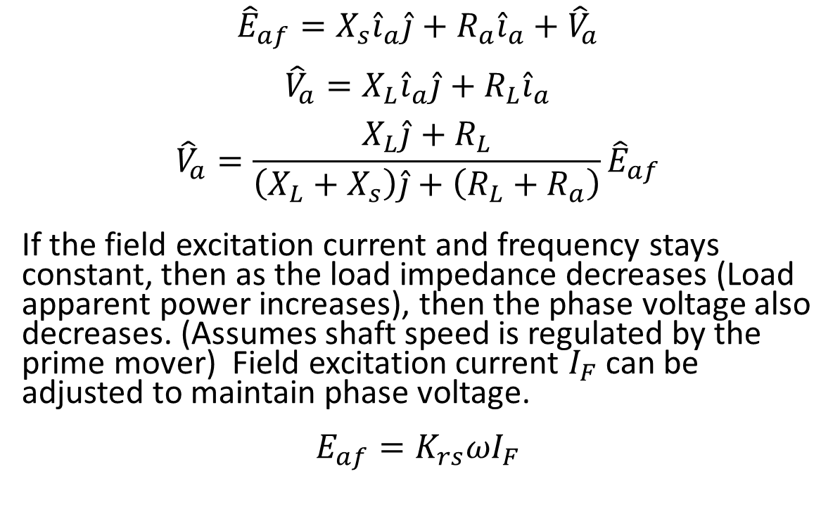
Steady State AC Synchronous Generator Theory – Not connected to the grid
$${\hat{E}}_{af}=X_{s}{\hat{i}}_{a}\hat{j}+R_{a}{\hat{i}}_{a}+{\hat{V}}_{a}$$
$${\hat{V}}_{a}=X_{L}{\hat{i}}_{a}\hat{j}+R_{L}{\hat{i}}_{a}$$
$${\hat{V}}_{a}=\frac{X_{L}\hat{j}+R_{L}}{\left(X_{L}+X_{s}\right)\hat{j}+\left(R_{L}+R_{a}\right)}{\hat{E}}_{af}$$
If the field excitation current and frequency stays constant, then as the load impedance decreases (Load apparent power increases), then the phase voltage also decreases. (Assumes shaft speed is regulated by the prime mover) Field excitation current $I_{F}$can be adjusted to maintain phase voltage.
$$E_{af}=K_{rs}ωI_{F}$$

Slide 10
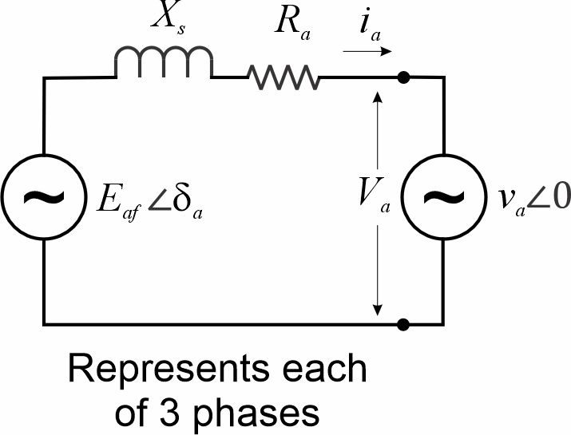
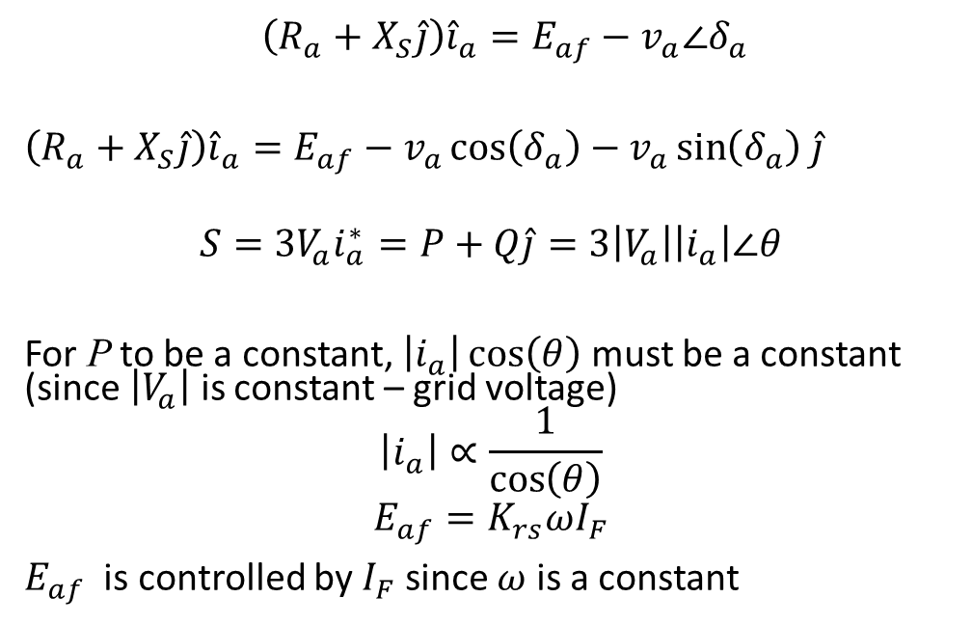
Steady State AC Synchronous Generator Theory – Connected to the grid
${\left(R_{a}+X_{S}\hat{j}\right)\hat{i}}_{a}=E_{af}−v_{a}∠δ_{a}$
${\left(R_{a}+X_{S}\hat{j}\right)\hat{i}}_{a}=E_{af}−v_{a}\cos\left(δ_{a}\right)−$ $v_{a}\sin\left(δ_{a}\right)$ $\hat{j}$
$$S={3V}_{a}i_{a}^{∗}=P+Q\hat{j}=3\left|V_{a}\right|\left|i_{a}\right|∠θ$$
For P to be a constant, $\left|i_{a}\right|\cos\left(θ\right)$ must be a constant (since $\left|V_{a}\right|$ is constant – grid voltage)
$$\left|i_{a}\right|∝\frac{1}{\cos\left(θ\right)}$$
$$E_{af}=K_{rs}ωI_{F}$$
$E_{af}$ is controlled by $I_{F}$ since $ω$ is a constant

Slide 11
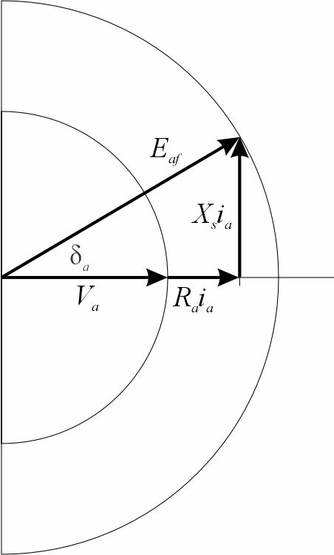
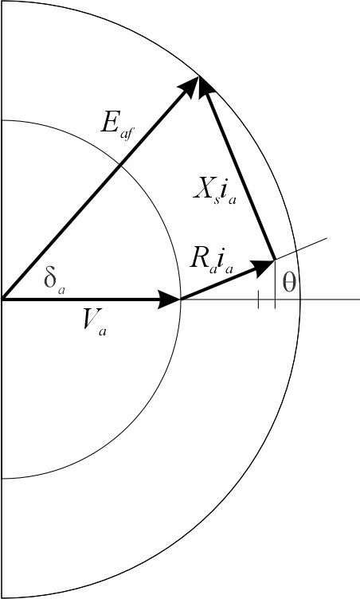
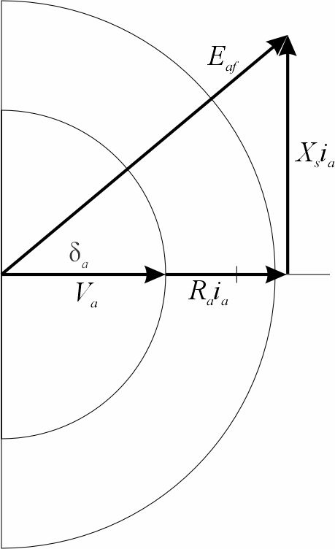
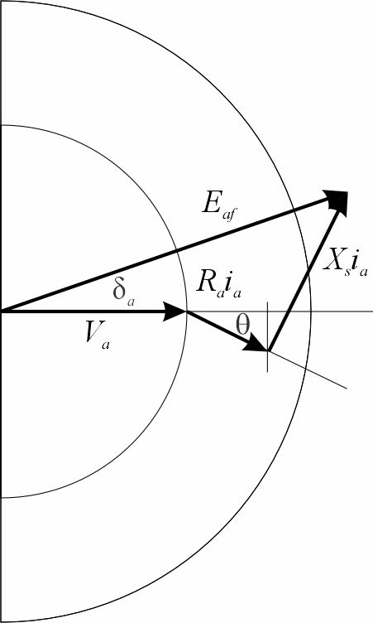
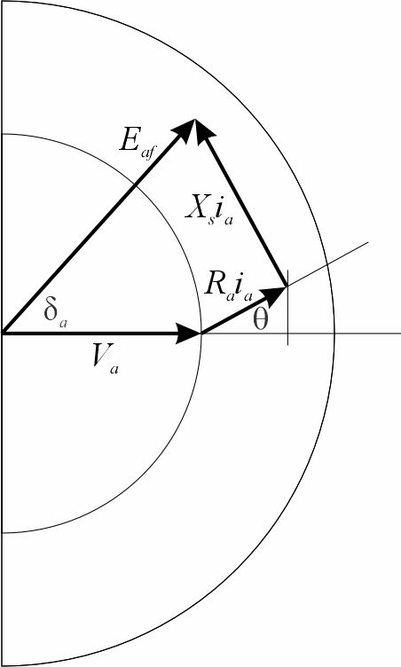
Steady State AC Synchronous Generator Theory – Connected to the grid
Baseline Case
Supplying
Unity Power Factor
(PF = 1.0)
Increased Excitation
on DC Motor
Same E_{af}
Power Increases
Power Factor supplies
Leading Loads
Increased Excitation
on DC Motor
Increased E_{af}
Supplying
Unity Power Factor
(PF = 1.0)
Baseline Excitation
on DC Motor
Increased E_{af}
Supplying
Lagging Loads
Baseline Excitation
on DC Motor
Decreased E_{af}
Supplying
Leading Loads

Slide 12
Procedure –Paralleled
Parallel Generator to the Grid
  Adjust Excitation on AC Generator to supply unity power factor
Increase excitation on DC Motor
  Measure Real and Reactive Power
Adjust excitation on AC Generator to supply Unity Power Factor
  Measure Real and Reactive Power
Increase excitation on AC Generator
  Measure Real and Reactive Power
Decrease excitation on AC Generator
  Measure Real and Reactive Power

Slide 13
Steady State AC Synchronous Generator Theory – Connected to the grid
Baseline Case
Supplying
Unity Power Factor
(PF = 1.0)
Increased Excitation
on DC Motor
Same E_{af}
Power Increases
Power Factor supplies
Leading Loads
Increased Excitation
on DC Motor
Increased E_{af}
Supplying
Unity Power Factor
(PF = 1.0)
Baseline Excitation
on DC Motor
Increased E_{af}
Supplying
Lagging Loads
Baseline Excitation
on DC Motor
Decreased E_{af}
Supplying
Leading Loads

Slide 14
Procedure – Not Paralleled
Adjust excitation to achieve 60 Hz and 208 volts line-to-line with 1200 ohm Load
  Measure Real and Reactive Power
  (should be about 12 watts per phase)
Turn on 300 and 1200 ohm resistors for the load
  Measure Real and Reactive Power
  (should be less than 60 watts per phase)
  Measure Frequency and voltage
  (should be less than 60 Hz, and 208 volts)
Adjust DC motor field excitation to return to 60 Hz.
  Measure Real and Reactive Power
  (should be closer to 60 watts per phase)
  Measure Frequency and voltage
  (should be 60 Hz and closer to 208 volts)
Adjust AC Generator field excitation to return to 208 volts line-to-line
  Measure Real and Reactive Power
  (Should be closer to 60 watts per phase)
  Measure Frequency and voltage
  (Should be a little less than 60 Hz and 208 volts)

Slide 15
Wrap Up

